Slide 1
Summary of Predictive Analytics Report for Conagra Brands
Shiva Kumar Reddy Koppula
BUAN 6337 - Section S24

Slide 2
Introduction
Market Trend
Significant shift towards plant-based diets for health and environmental benefits.
Gardein's Growth:
Outperforming sales projections, especially in the Great Lakes region.
Leading products include Burger Patty, Meat Substitute Ground, and Breakfast Sausage Patty.
Conagra's Strategy
Acquired Gardein (2014) and Pinnacle Foods (2018) to enhance focus on sustainable, healthy food options.
Continues to lead with innovation in taste, texture, and variety in meat substitutes.
Future Focus: Expand product lines and explore new market strategies. Drive growth through strategic marketing, targeted promotions, and enhanced distribution.

Slide 3
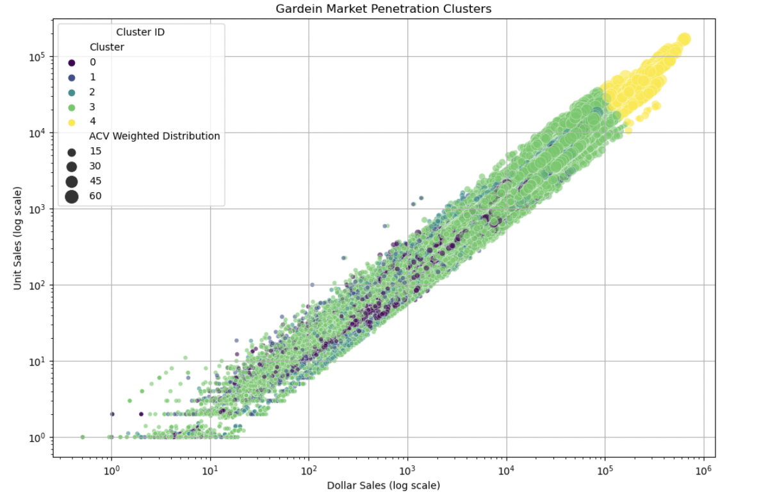
Strategy 1: Expanding Gardein's Market Reach
Objective
Enhance Gardein's market presence and performance across diverse product lines.
Methodology: Utilized K-means clustering
Cluster-Specific Strategies
Emerging Products: Boost visibility with products like Seven Grain Crispy Tenders.
Moderate Performance: Enhance visibility of Mandarin Orange Crispy Chick’n.
Established Potential: Innovate with Chipotle Black Bean Burger for global markets.
High Performance & Leaders: Strengthen loyalty with Beefless Ground; market Meatless Meatballs with sustainability focus.

Slide 4
Strategy 1: Expanding Gardein's Market Reach
Monitoring and Evaluation Performance metrics:
Track sales growth, market share, and promotional effectiveness.
Feedback mechanisms: Conduct consumer surveys and retailer feedback sessions.
Quarterly reviews: Adjust strategies based on performance assessments.

Slide 5
Strategy 2: Regional Expansion Opportunities for Gardein
Objective
Pinpoint growth regions and product forms for Conagra's Gardein brand.
Methodology
Regression analysis to identify strong and weak performing regions and product forms for Conagra and competitors.
Key Insights
Underperforming: Burgers show negative sales impact in several regions.
Strong Performers: Filet excels in California; Tender and Link show positive sales in multiple regions.
Competitive Analysis
Mixed results for burgers among competitors.
Consistent success for Link and Tender across competitors.
Strategic Actions
Revise Burger Strategy: Address underperformance.
Boost Strong Products: Expand marketing for Filet in California; increase Tender and Link distribution.
Conclusion: Refine market strategies based on regional sales data and competitor performance.

Slide 6
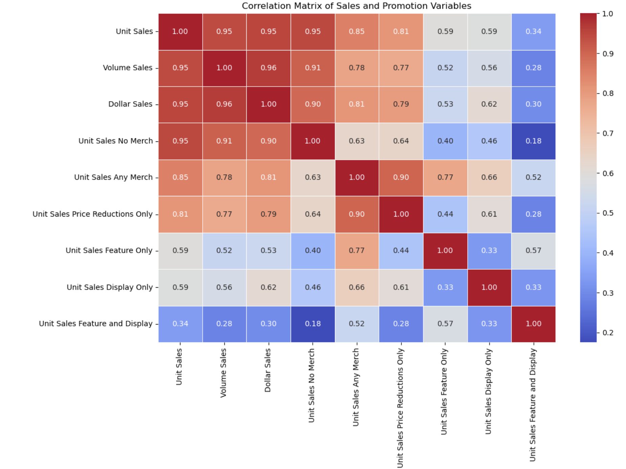
Strategy 3: Optimizing Promotional Impact
Key Insights:
Strong sales occur naturally, showcasing brand strength.
Price reductions drive significant sales, highlighting consumer price sensitivity.
Combined promotions (feature and display) show limited effectiveness.
Strategic Actions:
Focus on Quality: Emphasize product quality and sustainability in marketing.
Dynamic Pricing: Implement responsive pricing strategies during key sales periods.
Revise Promotions: Improve or innovate underperforming promotional methods.
Utilize Analytics: Leverage data for real-time promotional adjustments.
Engage Customers: Strengthen feedback mechanisms to tailor product offerings.

Slide 7
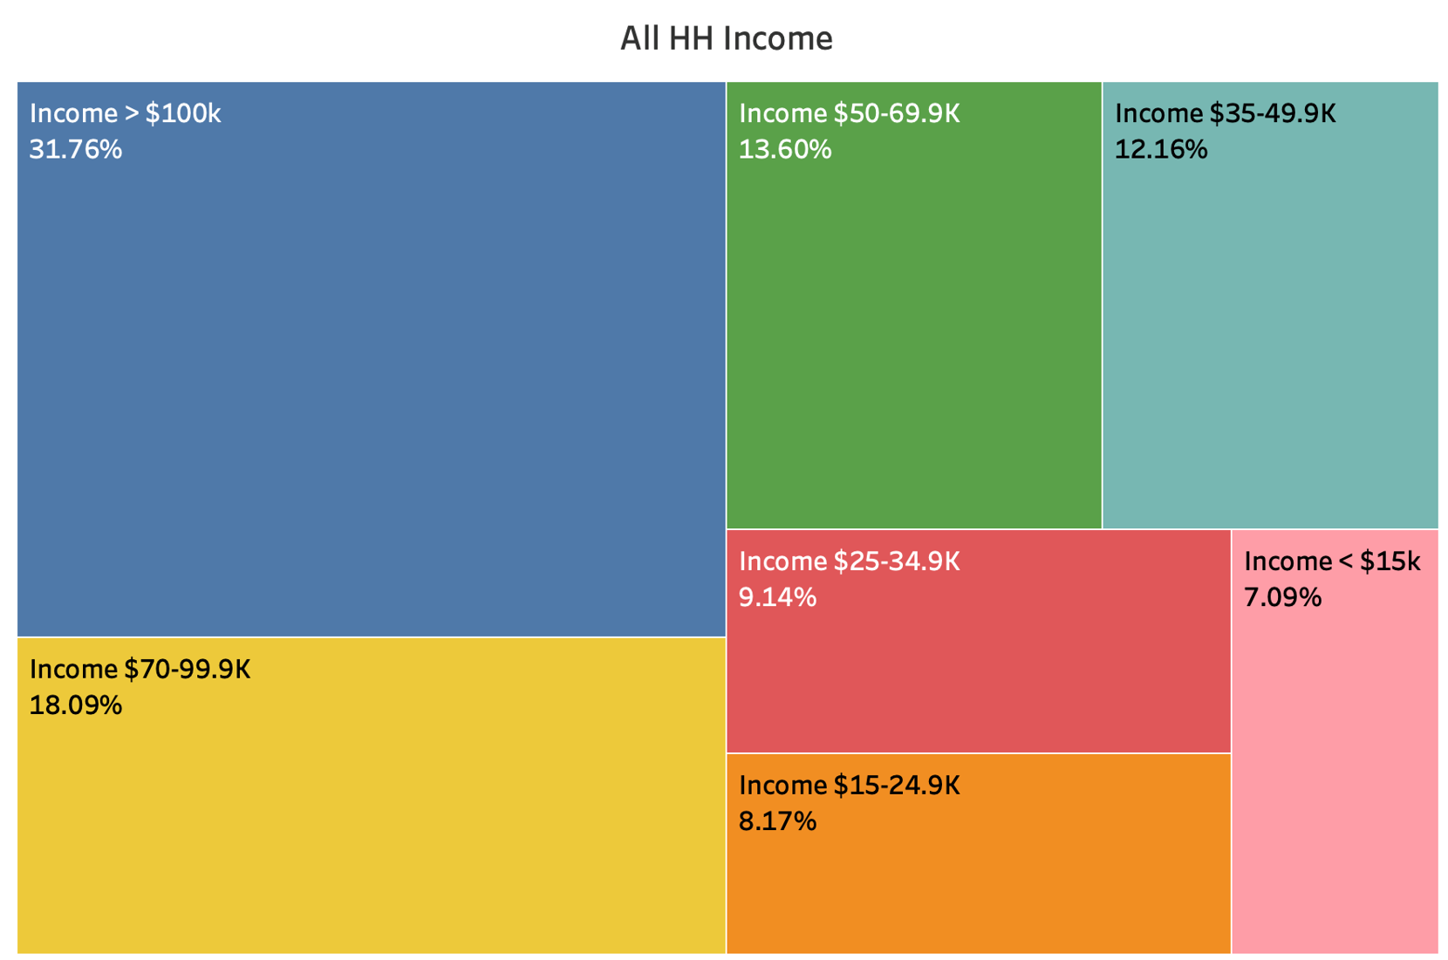
Strategy 4: Market Penetration in Different Income Segments
Current Appeal:
Strong appeal among households with income >$100k.
Potential for increased consumption in lower-income brackets.
Strategic Actions:
Price Sensitivity: Offer smaller pack sizes and value deals to attract price-sensitive consumers.
Distribution Expansion: Enter stores frequented by lower-income demographics.
Targeted Marketing: Craft campaigns that highlight the value and nutrition of products, appealing directly to lower-income households.
Product Innovation: Develop new variations suited to the preferences of lower-income consumers.
Promotional Incentives: Utilize discounts and coupons to encourage trial.

Slide 8
Strategy 5: The Influence of Digital Engagement on Consumer Choices
Objective
Increase online market share by developing a direct-to-consumer sales channel.
Key Strategies
Launch E-commerce Platform: Enable direct purchases through Gardein's website.
Exclusive Offers: Provide special products and bundles only available online.
Subscription Services: Offer regular deliveries through subscription models.
Loyalty Programs: Reward repeat customers to encourage ongoing engagement.
Targeted Digital Ads: Drive traffic to the online store highlighting exclusivity and convenience.
Optimize User Experience: Ensure a seamless shopping experience with easy navigation and fast checkout.

Slide 9
Strategy 6: Enhancing Collaboration with Health-Focused Retailers
Goal
Boost Gardein’s presence and visibility in health-focused grocery stores.
Key Strategies
Retail Branding Partnerships: Establish dedicated Gardein sections in stores.
In-Store Promotions: Offer exclusive discounts and BOGO deals.
Co-Marketing Campaigns: Combine efforts in online and offline marketing.
Sampling Stations: Allow direct product tasting and engagement.
Loyalty Incentives: Integrate Gardein into store loyalty programs.
Exclusive Products: Launch store-specific product lines.

Slide 10
Summary
Strategic Focus
Product Diversification: Adapt and expand product lines to meet consumer demand.
Regional Expansion: Tailor strategies to regional market dynamics and competition.
Promotion Optimization: Shift focus to more effective promotional tactics like price reductions.
Digital & Retail Integration: Strengthen digital presence and collaborate with health-focused retailers.
Market Inclusion: Broaden consumer base across different income segments.
Conclusion
Ongoing innovation and targeted strategies aim to sustain growth and enhance market reach.

